Slide 1
Current Law v. SB 505 - Senator Miller/Luneau v. HB 871 – Representative Henry
2024 Louisiana Proposed Legislation Comparison
Compiled By Wesley Eby Johnson
E & P Consulting, LLC

Slide 2
Two Different Proposed Laws Moving Through the Louisiana Legislature Related to Property Taxes
If either passes, significant changes for political subdivisions.
Each proposed law is large - around 75 pages long
State Constitutional Amendment also pending for November ballot
Changes begin to apply as early as the current tax year
Better to start talking about possible changes now

Slide 3
Act 819 - 2009
Passed by the 2008 Legislature and was 100 pages long
It months/years for local governments to understand how to implement that new law
What do we need to prepare to do and why?
Start thinking about how this can best be accomplished if either law is passed
Short amount of time left to provide input

Slide 4
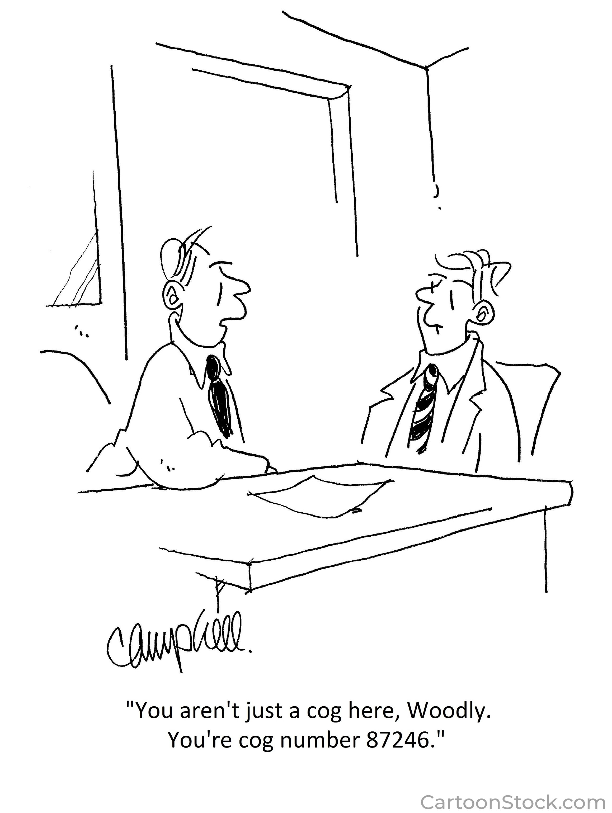
Each Government/Department Must Know What the Others Will Have to Do Differently
Forms for Notice will be completely different
Verbiage will change somewhat with HB 871 -- and significantly with SB 505
Both replace the term “ad valorem taxes” with “statutory impositions”
SB 505 replaces other terms: “redemption” –> termination price”

Slide 5
How Will the Forms (Notices) Be Different?
Some changes are only to verbiage
1% interest is non-compounding
Some changes relate to new or different requirements:
The notice shall indicate if there is a prior unredeemed tax sale certificate or tax lien certificate in connection with the immovable property.
Notices must still be sent to tax debtor and tax notice parties
New laws make it clearer that it is an auction for a tax lien
Official Publication Notice: Both require a different Notice than currently published in the official publication but only 1 * (rather than 2 *)
SB 505 removes requirement that Notice be only in English
The “tax lien certificate” (SB 505) or “tax auction certificate” (HB 871) will be filed in the mortgage records (instead of conveyance records)
Certificate of Redemption → Certificate of Termination & new verbiage on certificate

Slide 6
Who receives the tax bill the year after a tax sale?
Currently – individual who purchased tax sale certificate receives the tax bill the following year and “shall” pay it….
Both laws change this – tax lien purchaser is not added to the tax roll
Currently tax notice parties request to be notified of tax bill
SB 505 – notice is only good for one year unless a mortgage holder.
Both add a requirement that the tax collector must inform tax lien certificate holder of any person or entity requesting notice

Slide 7
Redemption Time Periods Could Change:
HB 871 leaves adjudicated property statutes intact.
HB 871 still ends tax collector’s involvement with tax sale certificates purchased at auction and after 3 years - cannot redeem w/ tax collector.
Redemptions → Lien Terminations (SB 505):
Redemptions for tax sales or tax certificates prior to 1/1/25 shall be made in accordance with the law in effect at the time of the sale. Tax collector’s system must address properties differently based on their tax sale date.
Tax collector must provide foreclosing lien holder with a statement certifying the amount of the termination price as of the date of the statement.
Tax lien holder must attach this statement to their petition.
Tax lien holder must send a copy of their petition to the tax collector among other requirements.
Anyone with an interest in the property must be served and the tax lien certificate holder must notify the tax collector in writing of the date on which each party is served.
Tax collector is prohibited from accepting lien terminations after 30 days from service of all parties

Slide 8
No more bid down for percentage interests
Tax lien certificates or tax auction certificates auctioned for 100% interest
Tax lien/auction certificate prescribes after 7 years
SB 505 – bid down is for the percentage interest the bidder is willing to accept -- .9% - .8% - until 0?
Winning bidder is willing to accept lowest interest
HB 871 – Winning bidder is the first one to place the bid in time.
No computer generated/automated bids allowed

Slide 9
What if there is no bid on a property?
Currently – Adjudicated Property – tax-sale title goes to the political subdivision who can sell, donate or take themselves after redemptive period by taking specific steps involving notice and ending with filing a nonwarranty deed in conveyance records
Political subdivision does not have to take action and has no liability
Tax debtor (or anyone on their behalf) can redeem at any time prior to the filing of nonwarranty deed.
HB 871 – Makes no changes to current law regarding adjudicated property
SB 505 deletes the definition of “adjudicated property”
SB 505 – transfers the tax lien certificate for any properties receiving no bid to the political subdivision
Political subdivision must go through full foreclosure (ordinary proceeding: ie. A lawsuit + sherrif sale) or tax lien prescribes after 7 years
Political subdivision can transfer the tax lien certificate to a 3rd party who must take action to foreclose (ie. No non-warranty deed) or lien will prescribe after 7 years

Slide 10
Tax Roll Delivery
SB 505 changes current law stating assessor may file tax roll in mortgage records to say that the assessor shall deliver the tax roll to the recorder of mortgages. Official approval must also take place.
Both proposed laws leave obligation to list co-owners on tax roll, but remove obligation to notify tax sale purchaser (except they will not be called tax sale purchasers anymore)
SN 505 mandates that they not be listed: The assessor shall not list the name of a tax lien certificate purchaser on the tax roll.
HB 871 removed authority for assessor to make separate assessments for undivided interests in a tax parcel (currently something that assessor can do, but doesn’t have to do)

Slide 11
Different Situations Tax Collectors May Encounter Moving Forward:
Tax Liens from Previous Years:
Tax Liens for Subsequent (Future) Years:
A tax lien/auction purchaser can redeem a previous outstanding tax auction certificate / the 7 year prescription will still apply to those
HB 871 - Tax collector required to make reasonable efforts to notify a redeeming party of the existence of any additional tax auction certificates within tax collector’s authority that are outstanding
SB 505 – Tax lien certificate holder must notify the tax collector at the time of the lien termination of his status as certificate holder or 5%/1% interest does not accrue
Tax auction purchaser can pay tax bill in future years if tax debtor does not pay, but do not have to (although another tax auction could occur)
Tax lien certificates will be treated equally to one another – not first in time.
The tax debtor does not have to terminate all his tax liens → if they pay less than the total of all outstanding liens, the tax collector must terminate the lien that the tax debtor identifies for termination.
If the tax debtor gives no directions in this situation, the oldest terminable (ie. Not prescribed) tax lien certificate should be terminated.

Slide 12
Currently - After Tax Sale and within 90 days of redemption period – Another Specific Notice by first class mail by the tax collector in a Specific Form
HB 871 – Post auction notice
Tax collector shall send a notice within 30 days of filing tax auction certificate or as soon as practical thereafter (US mail) – includes “no nullity in case of tax collector failing to send notice” language
At least 6 months prior to expiration of redemptive period tax collector shall send notice to tax auction parties
SB 505 – Tax lien certificate holder sends the notice no more than 365 days and no sooner than 180 days prior to bringing action to foreclose
Notice must include a payment schedule for the greater of 6 months or the remaining period prior to foreclosure giving the amount to be paid to terminate the tax lien through the last day of each month. (Must get this from the tax collector)
Political subdivision = tax lien certificate holder for properties receiving no bids = also obligated to do these things
After sending the notices, lien holder can submit an affidavit of costs and fees to the tax collector attesting to costs (no more than $500). (Added to redemption/lien termination)

Slide 13
More Regarding Redemptions
Currently – Tax sale certificate generated and filed - tax collector calculates same interest/penalty for all redemptions
SB 505 – Tax Lien Certificate – monthly interest rate and percentage penalty determined by winning bid will be different for each / Tax collector must file this certificate within 30 days after auction
When lien is terminated – tax collector must calculate:
1% until auction
___% after the auction (whatever the winning bidder bid)
HB 871 – Tax auction certificate – same 5% and 1% per month for all winners of 100%

Slide 14
SB 505 – No More New Adjudicated Property Also - If Adjudicated property sale results in more $ than tax bill/money owed
Political subdivision must hold onto excess proceeds for one year for people holding an interest in property
Must send a notice to each tax lien party within 30 days of sale
Parties may submit applications to receive their portion of the proceeds by sending an affidavit to the political subdivision asserting facts to prove their proportional interest
No applications = political subdivision keeps $
NOTE: Not sure that this is even relevant bc significant portions of adjudicated property law are being repealed by SB 505

Slide 15
Assignment of Tax Liens May Now Involve Tax Collector
Currently – Quitclaim Deed filed in conveyance records
HB 871 does not provide for an assignment of a tax auction certificate
SB 505: Allows a transfer of a tax lien certificate & requires:
Filed with mortgage records and notice delivered to the tax collector
This includes tax lien certificates held by political subdivision because of no-bid situation that are transferred to new parties.
Political subdivisions can also convert adjudicated property to tax lien certificates and donate or sell
Foreclosure still must occur before 7 years from the date of recordation.

Slide 16
Repairs/Improvements
SB 505 similar to current law, has the privilege on the property for court mandated repairs terminating after 5 years. Unclear if costs are part of redemption.
HB 871 allows a tax auction purchaser in possession of a notice or order from a political subdivision advising of property standards violations to take peaceful possession of a vacant or abandoned property without a court order and without consent from the tax debtor for the purpose of complying with the notice requirements
In this situation, no force or violence is allowed, tax auction purchaser must relinquish property back to tax debtor within 30 days of receipt of written demand and cannot alter property beyond political subdivision’s requirements & Records Affidavit of Costs to Preserve in Mortgage Records that can be refiled on an annual basis (grass cutting, etc.) & included in redemption fee

