Slide 1
Title Tangles: Adjudicated Property, Taxing Authorities, and the Quest for Reform
2024 Louisiana Legislation on Tax Sales
Comparison & Preparation for Implementation
Wesley Eby Johnson
E & P Consulting, LLC
318-807-0924
www.louisianalandsolutions.com

Slide 2
ACT 819 - 2009
Passed by the 2008 Legislature and was 100 pages long
Tax-Sale-Presentation-Michael-Bealer.pdf (louisianaassessors.org)
ACT 774 effective 1/1/26

Slide 3
Different Laws Related to Property Taxes Moved Through the 2024 Louisiana Legislature to become ACT 774
HB 871 SB 286 SB 393
SB 286 + SB 393 → SB 505
SB 505 passed (ACT 774) effective 1/1/26, but was contingent on passage of Constitutional Amendment 4 on the ballot in December per SB 118 (ACT 409)
Amendment 4 passed – ACT 774 goes into effect 1/1/26
New law is around 81 pages long

Slide 4
Tax Lien Certificates
Starting in 2026 - liens against property will be sold each year if statutory impositions not paid) (47:2160.1)
Tax lien certificate will be filed in the Mortgage Records
Lien is on the whole property (no more in-division percentage ownership interests)
No more bid down for percentage/undivided interests in the property
Bid down is for the interest percentage the bidder is willing to accept in increments of no less than 1/10 of 1% with the lowest bid being 7/10 of 1% so ------ .9% - .8% - until .7%
Winning bidder is willing to accept lowest interest
Pari Passu – equal rank + priority over all other encumbrances
The lien prescribes after 7 years -- Preemptive La. R.S. 47:2155(C)
No prescription while held by political subdivision: “Prescription shall be suspended during any period in which the tax lien certificate is issued to and held by a political subdivision.”

Slide 5
YEAR 1
YEAR 2
YEAR 3
2026
2027
2028
2029
Tax Lien Certificate
-> filed in
M records
YEAR 4
Latest That 365 -180 Day Foreclosure Notice can be sent
Earliest That 365 -180 Day Foreclosure Notice can be sent
2030
Lien Prescribes
YEAR 5
YEAR 7
YEAR 6
2031
2033
2032

Slide 6
ACT 775: La. R.S. 47:2246 PROPERTY RECEIVING NO BID
“Tax sale title” not purchased at auction = “Adjudicated Property” Post ACT 819 & Pre ACT 774
Tax sale title goes to the political subdivision who can sell, donate or take themselves after redemptive period by taking specific steps involving notice and ending with filing a nonwarranty deed in conveyance records
ACT 775: La. R.S. 47:2246 PROPERTY RECEIVING NO BID
A tax lien certificate for a property receiving no bid is transferred to the to the political subdivision and filed in the mortgage records
Regardless of whether it is purchased or receives NO BID:
All subsequent tax bills are sent to the tax debtor -- La. RS 47:2160.1
Tax lien holder shall receive tax bill upon request unless bills are online (La. RS 47:2160.1(B))
47:2159 – Tax notices / $20 year to year / Except Mortgage holders – until cancelled

Slide 7
Local Government’s Options Beginning in 2026
1: Continue to sell adjudicated property per local ordinance → Nonwarranty Deed
2: Political subdivision can transfer a tax lien certificate to a 3rd party who must take action to foreclose (ie. No non-warranty deed) or lien will prescribe after 7 years from transfer → supposed to result in Warranty Deed
3: Political subdivision can also convert previously adjudicated property to a tax lien certificate → See Option 2
4: Political subdivision can also transfer the immovable property burdened by the tax lien in accordance with terms of local ordinance → Nonwarranty Deed? See Option 1?

Slide 8
Option 1 Continue to sell adjudicated property per local ordinance
The current inventory of adjudicated property does not automatically change into anything else
Nonwarranty Deed is sold
Acquisitive Prescription – La. RS 47:2288
Lot Next Door – La RS 47:2202(B)
Slightly revised versions of La. RS 47:2201, 47:2202, 47:2203, 47:2204, 47:2206, 47:2207 remain
“Acquiring Person” definition has expanded
Moving forward Statutory Notices must be sent to: “tax auction parties”
La. RS 47:2206 Mandates that if the notice is returned for any reason additional steps must be taken

Slide 9
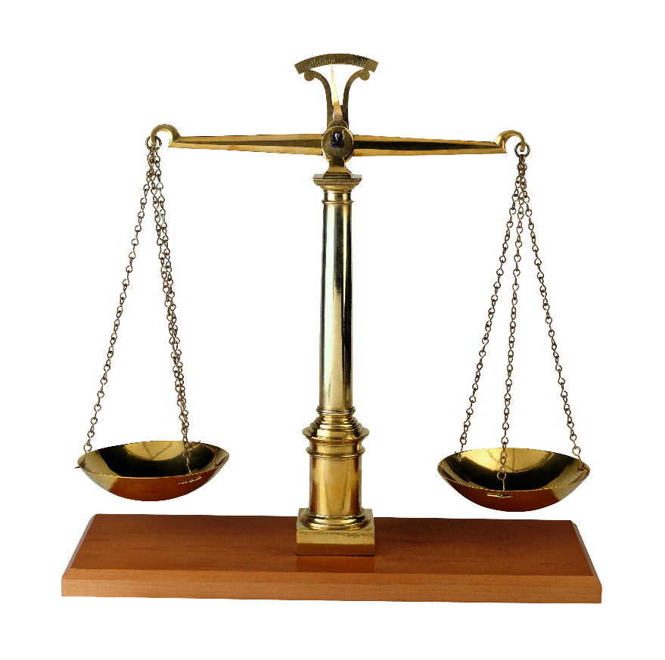
Acquiring Person (La RS 47:2122(1)
(a) A person acquiring tax sale title to at a tax sale property conducted prior to January 1, 2009.
(b) A political subdivision or any other person seeking to acquire or acquiring ownership of adjudicated property.
(c) A person acquiring tax sale title to a tax sale property at a tax sale conducted after January 1, 2009, but before January 1, 2026.
(d) A person acquiring the delinquent obligation at a tax auction after January 1, 2026.
PRE ACT 819
POST ACT 819 + ACT 774
Option 1
POST ACT 819
ACT 774

Slide 10
Tax Auction Party (47:2122(14)) Anyone who will lose interest in property (Mortgage holders, etc.):
Tax notice Party
Owner of property, including owner of record at the time of the tax lien auction as shown in the conveyance records in the parish
Any reasonably locatable person holding an identifiable ownership interest or usufruct interest even if not shown in the conveyance records of the parish where the property subject to the lien is located
Any other person holding an interest such as a mortgage, privilege

Slide 11
La. RS 47:2206 Notice of sale or donation of adjudicated property
Notice after 3 years of recordation of tax sale certificate or tax lien certificate = intent to sell
If written notice to tax sale party or tax auction party is returned, must take additional steps (at least three of these):
(a) Review the local telephone directory or internet for the tax sale party or tax auction party.
(b) Contact assessor for potential updated addresses of the tax sale party or tax auction party
(c) Examine the mortgage and conveyance records of the parish where the property is located to determine whether there are any other transactions pertaining to the tax sale party or tax auction party
(d) Perform a computer search of digitized records and databases of the clerk of court or sheriff's office for addresses of properties that may be owned by the tax sale party or tax auction party
(e) Search the business entity records of the Louisiana secretary of state or the equivalent records in which an identified entity was formed or maintains its principal place of business.

Slide 12
If Adjudicated Property Sale results in more $ than tax bill/money owed
Tyler v. Hennepin (2023)
The U.S. Supreme Court curbed state and local governments from seizing and selling the homes of people with unpaid property taxes and keeping the proceeds beyond the amount owed, deeming the practice unconstitutional in a ruling in favor of a 94-year-old woman who battled tax authorities in Minnesota.
Tyler had owed roughly $15,000 in property taxes, including interest and fees. The county foreclosed on her home and in 2016 sold it at auction for $40,000, keeping the balance for its own use.
ACT 774: Political subdivision must hold onto excess proceeds for people holding an interest in property (La. RS 47:2211)
“Shall notify” tax lien party no later than 30 days after the sale
Parties may submit applications to receive their portion of the proceeds by sending an affidavit to the political subdivision asserting facts to prove their proportional interest
No applications = political subdivision keeps $ after one year from sending
Political subdivision can recoup costs

Slide 13
Option 2 Transfer the tax lien certificate
Through Sale or Donation
Lien can be terminated by or on behalf of the tax debtor (redeemed) anytime before foreclosure*
Termination of a lien = what we know of as redemption
No notice requirements before transferring a tax lien certificate are required. (47:2206(D))
La. RS 47:2153.1. Exclusion of certain delinquent obligations from tax lien auction (relevant in 2027+)
“Delinquent obligations related to immovable property encumbered by a tax lien certificate issued to and held by a political subdivision may be excluded from a tax lien auction at the election of the political subdivision. As soon as practical after being directed by the political subdivision to exclude a delinquent obligation from the tax lien auction, the tax collector shall file a tax lien certificate in favor of the political subdivision in the mortgage records”
No foreclosure until 3 years after tax lien certificate filed in M records (47:2266.1) and required notices between 365-180 prior to foreclosure (47:2156) so implementing 47:2153.1 and waiting until after year two to transfer could be desired…..

Slide 14
YEAR 1
YEAR 2
YEAR 3
2026
2027
2028
2029
Tax Lien Certificate =
NO BID -> filed in
M records
Lien is in the name of
political subdivision
Tax Lien Certificate could be sold to a 3rd Party unless political subdivision implements 47:2153.1
YEAR 4
Earliest That 365 -180 Day Notice can be sent for the 2026 lien
2030
YEAR 5
YEAR 7
YEAR 6
2031
2033
2032

Slide 15
Foreclosure -- La. RS 47:2266.1
365/180 Day Notice -- La. RS 47:2156
This is the Notice required prior to foreclosure – send to tax auction parties
“As of [insert date no more than 15 days prior to notice] the termination payment is X plus costs…..
Certification from the tax collector must be provided by the tax collector upon request (copy must be attached to the petition – referred to as “a statement certifying the amount of the termination price”)
Recommended that it includes a payment schedule for at least 6 months of what is owed to stop foreclosure
Affidavit for up to $500 for notice costs can be submitted to tax collector & attached to petition
Foreclosure can be initiated after 3 years from the date of filing the tax lien certificate against “each owner”
Attorneys fees are 25% of the debt or $2,500 whichever is more
Curator must be appointed for absent defendant(s) - Termination of lien allowed until 30 days after last party served
Judgment enforced per La. RS § 47:2267

Slide 16
Sheriff Sale to Enforce the Judgment = Sheriff deducts costs of sale and any commission due and distributes the rest:
1. Lien holder for payment of judgment + judicial interest through date of sale & reasonable costs and attorneys fees
2. Holders of lien certificates that have not pre-empted
3. Holders of recorded mortgages, liens and privileges to satisfy each claim
4. To each owner in accordance with their interest
Disputes over surplus shall not delay issuance of sheriff’s deed to winning bidder or to distribution of judgment amount to plaintiff.

Slide 17
Option 3 Convert adjudicated property to a tax lien certificate
Authenticate the tax lien certificate and file in the M records
Purchaser to foreclose (or risk prescription)
Foreclosure cannot occur until 3 years after tax lien certificate is filed in M records
Bundling is allowed – group properties and sell or donate (47:2201(A))
Again, Notices are not required prior to transfer of tax lien certificates (47:2206(D))

Slide 18
Option 4. Political subdivision can also transfer the immovable property burdened by the tax lien in accordance with terms of local ordinance
Adjudicated property-ish → Nonwarranty Deed?
Minimum bid must be no less than 2/3 the market value “as established by the tax assessor” 47:2202(A)(5)
Same pre-notice requirements to tax auction parties prior to transfer as adjudicated property.
47:2204 – Additional terms of Ordinance….Same language as currently in place
No appraisal required
Terms and conditions set by local ordinance
Additional ordinance can be required to approve sale

Slide 19
YEAR 1
YEAR 2
YEAR 3
2026
2027
2028
2029
Tax Lien Certificate =
NO BID -> filed in
M records
Lien is in the name of
political subdivision
Tax Lien Certificate could be sold to a 3rd Party unless political subdivision implements 47:2153.1
Earliest That “immovable property encumbered by a tax lien” can be sold
YEAR 4
2030
YEAR 5
YEAR 7
YEAR 6
2031
2033
2032

